Slide 1



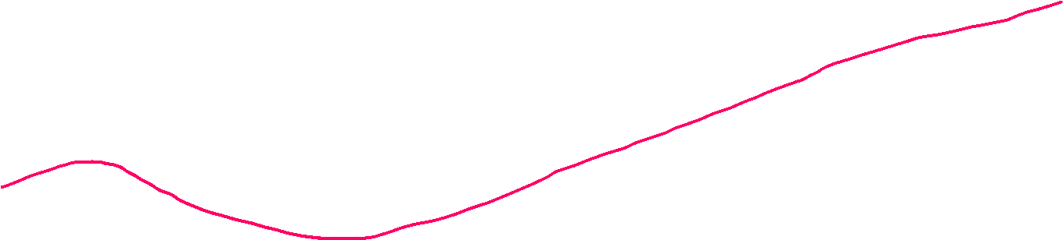
Furthering Usability and Efficiency of Massively Parallel Gaussian Process Regression as applied to Multi-Beam Sonar Data
Phillip Parisi – MS Thesis Defense
April 5th, 2023
University of Rhode Island

Slide 2
Furthering Usability and Efficiency of Massively Parallel Gaussian Process Regression as applied to Multi-Beam Sonar Data

Slide 3

Furthering Usability and Efficiency of Massively Parallel Gaussian Process Regression as applied to Multi-Beam Sonar Data
my work!

Slide 4
Furthering Usability and Efficiency of Massively Parallel Gaussian Process Regression as applied to Multi-Beam Sonar Data
existing work!

Slide 5
Furthering Usability and Efficiency of Massively Parallel Gaussian Process Regression as applied to Multi-Beam Sonar Data
better seafloor maps!

Slide 6
Furthering Usability and Efficiency of Massively Parallel Gaussian Process Regression as applied to Multi-Beam Sonar Data

Slide 7



$$y=f(x)$$
y is
dependent
x is independent

Slide 8



$$y=f(x)$$
y is
dependent
What is $f$?
x is independent

Slide 9
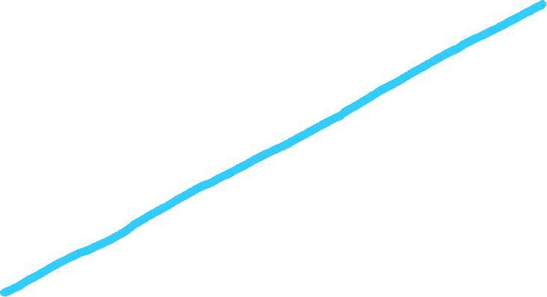
$$y=f(x)$$
y is
dependent
x is independent

Slide 10
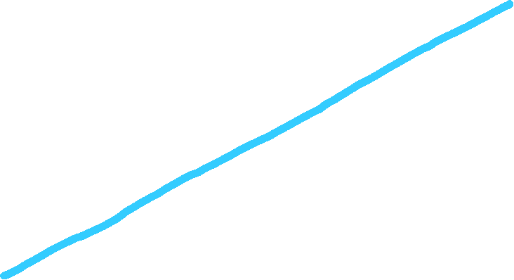

$$y=0.75x+2$$
y is
dependent
x is independent

Slide 11

parametric model
$$y=mx+b$$
y is
dependent
x is independent

Slide 12
parametric model
$$y=mx+b$$
inputs
x is independent

Slide 13
parametric model
$$y=mx+b$$
outputs
y is
dependent

Slide 14
parametric model
$$y=mx+b$$
outputs
y is
dependent

Slide 15

$$y=mx+b$$

Slide 16
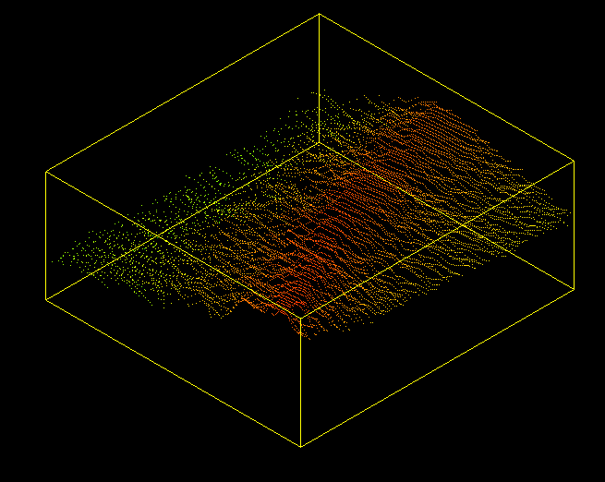




$$y= ???$$
$$y=mx+b$$

Slide 17
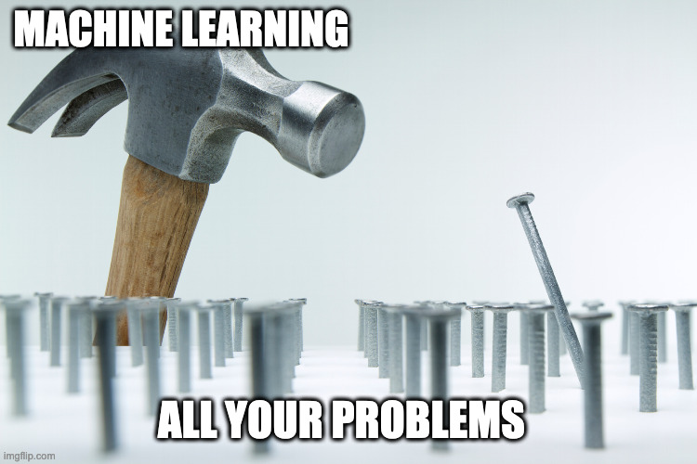



$$y= ???$$
$$y=mx+b$$

Slide 18
Furthering Usability and Efficiency of Massively Parallel Gaussian Process Regression as applied to Multi-Beam Sonar Data
machine learning!

Slide 19
Furthering Usability and Efficiency of Massively Parallel Gaussian Process Regression as applied to Multi-Beam Sonar Data
training data

Slide 20
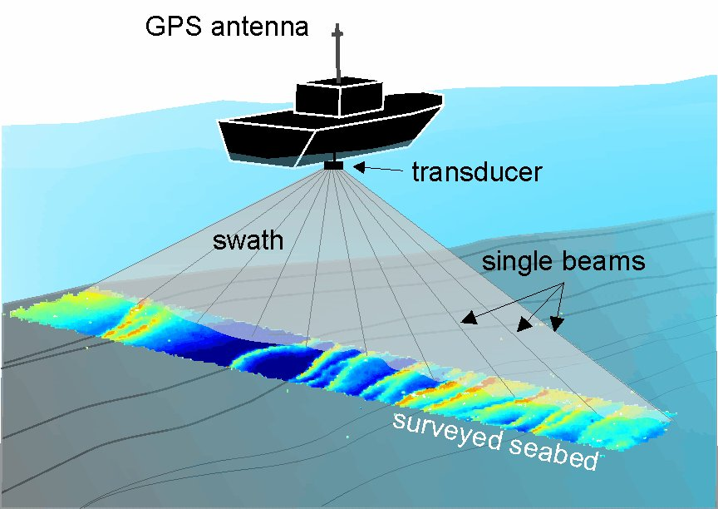
Sonar Data
latitude
depth
longitude

Slide 21
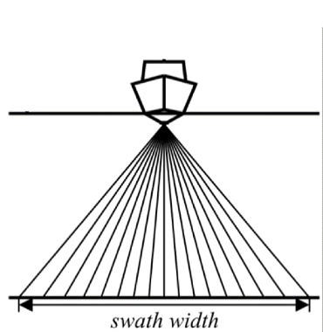
Sonar Data
ship
waterline
sonar beams
seafloor
high
uncertainty
low
uncertainty
high
uncertainty

Slide 22
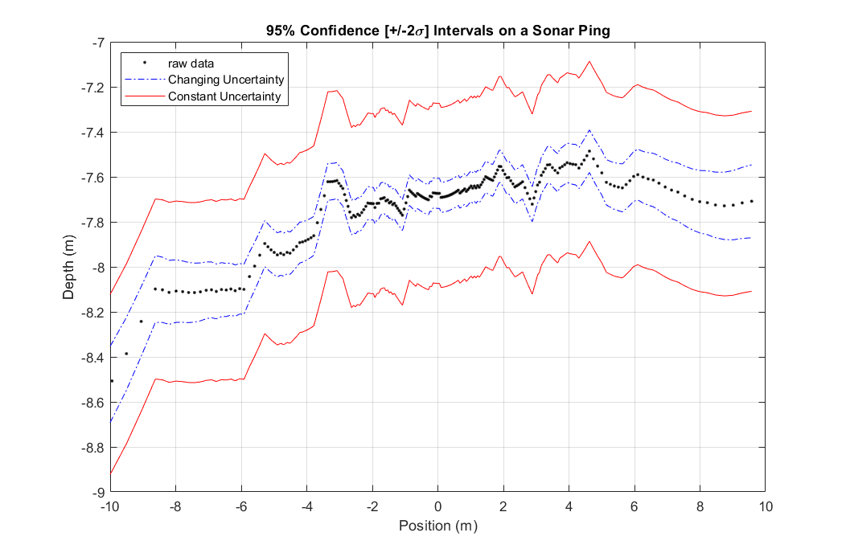
new model
old model

Slide 23
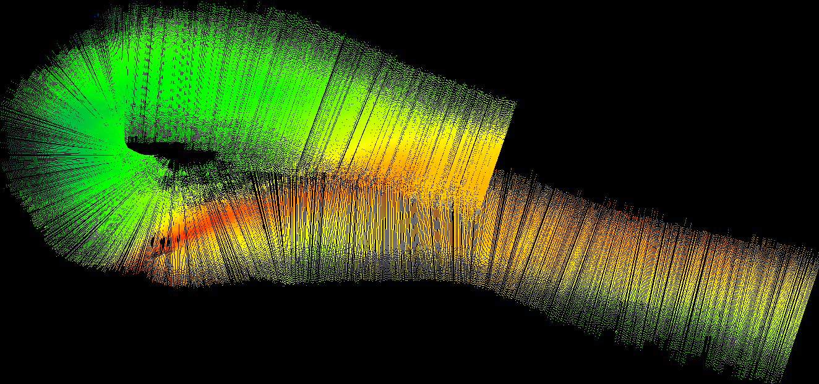
Sonar ‘Swath’
ship
ping of ~200 soundings

Slide 24
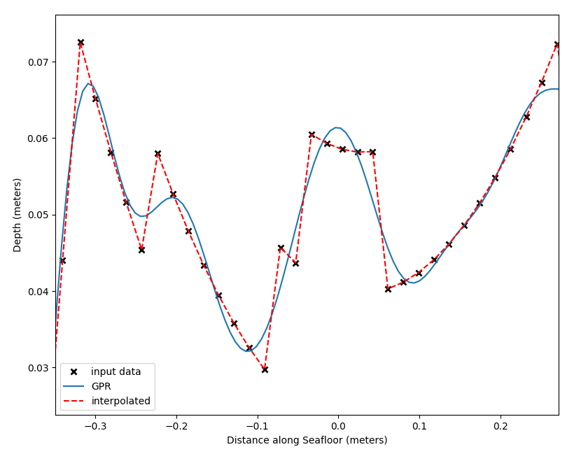

GPR on a Ping
smooth like sand
uncertainty of each
prediction

Slide 25

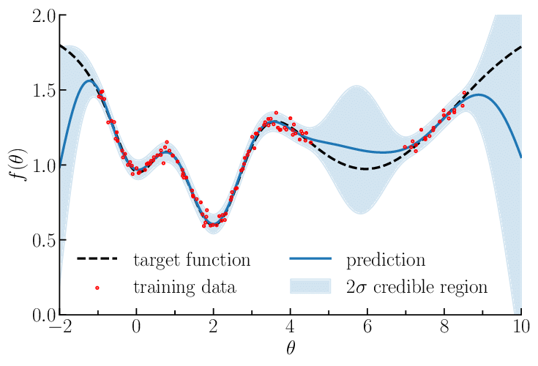
GPR on a Ping
smooth like sand
uncertainty of each
prediction
Depth (m)
Distance along seafloor (m)
Florent Leclerq – Research Gate

Slide 26
GPR on a Ping
🤔
In robotics, we want to know where our predictions are uncertain and where they are certain!
👍
Depth (m)
Distance along seafloor (m)
Florent Leclerq – Research Gate

Slide 27
GPR on a Ping
🤔
In robotics, we want to know where our predictions are uncertain and where they are certain!
👍
Depth (m)
Only GPR can
do this!!!
Distance along seafloor (m)
Florent Leclerq – Research Gate

Slide 28
Furthering Usability and Efficiency of Massively Parallel Gaussian Process Regression as applied to Multi-Beam Sonar Data
how does it work?

Slide 29
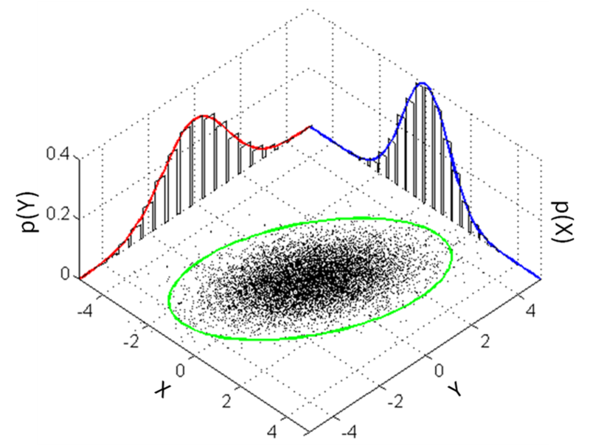
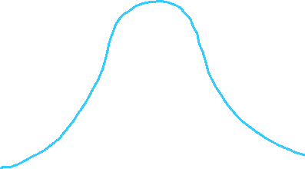











1-D Gaussian Distribution
n-D Gaussian Distribution
P(y)
P(x)

Slide 30
1-D Gaussian Distribution
n-D Gaussian Distribution
P(y)
P(x)

Slide 31

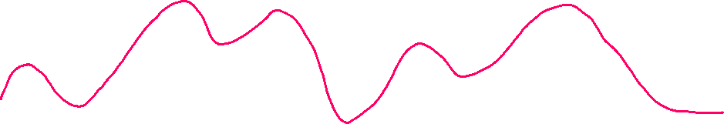
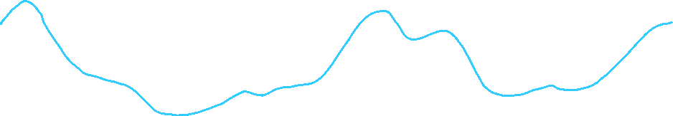
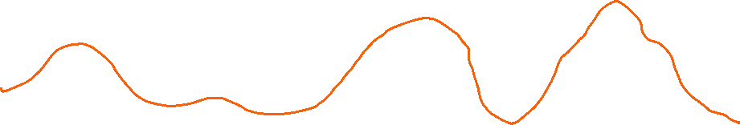
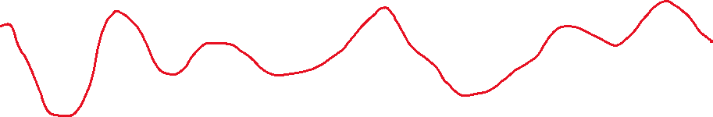
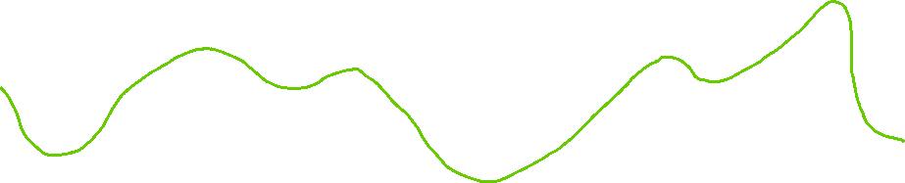
Gaussian process: collection of random variables
- any finite subset of them has a n-D gaussian distribution
- defined by a mean function (zero) and covariance function

Slide 32

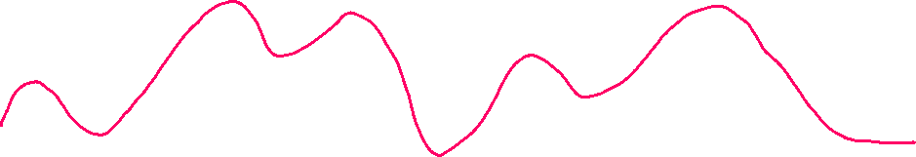
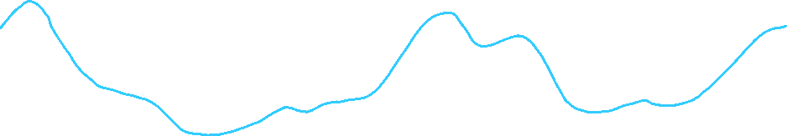



Gaussian process: collection of random variables
- any finite subset of them has a n-D gaussian distribution
- defined by a mean function (zero) and covariance function
prior distribution
“no data”

Slide 33

Gaussian process: collection of random variables
- any finite subset of them has a n-D gaussian distribution
- defined by a mean function (zero) and covariance function
conditioning
“using data”

Slide 34
Gaussian process: collection of random variables
- any finite subset of them has a n-D gaussian distribution
- defined by a mean function (zero) and covariance function
conditioning
“using data”

Slide 35
Gaussian process: collection of random variables
- any finite subset of them has a n-D gaussian distribution
- defined by a mean function (zero) and covariance function
conditioning
“using data”

Slide 36
Gaussian process: collection of random variables
- any finite subset of them has a n-D gaussian distribution
- defined by a mean function (zero) and covariance function
conditioning
“using data”

Slide 37
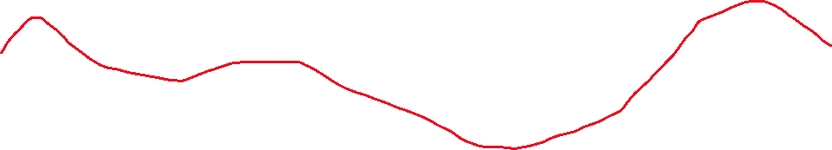
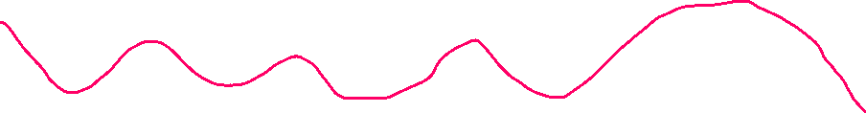
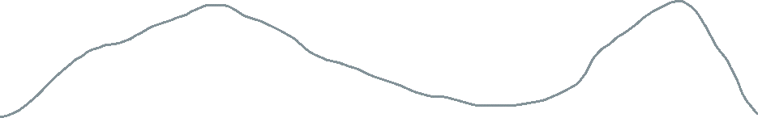
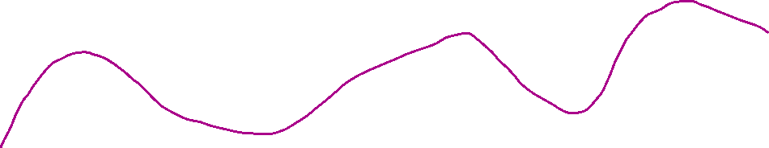
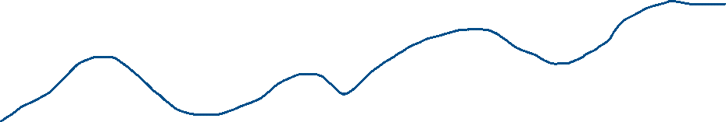
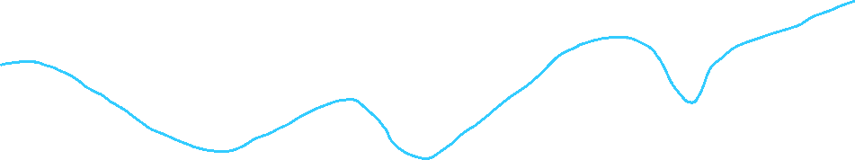
Gaussian process: collection of random variables
- any finite subset of them has a n-D gaussian distribution
- defined by a mean function (zero) and covariance function
infinite variables

Slide 38

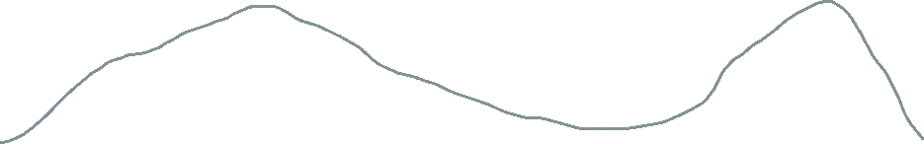

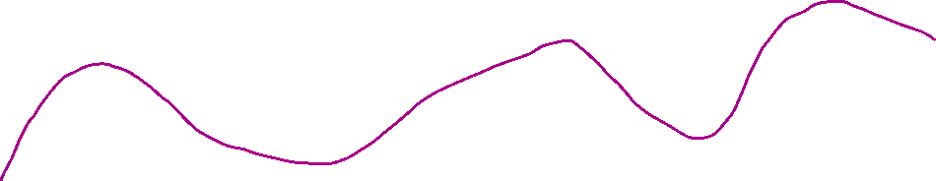
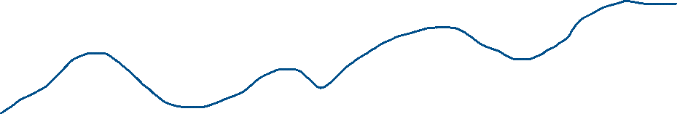




Gaussian process: collection of random variables
- any finite subset of them has a n-D gaussian distribution
- defined by a mean function (zero) and covariance function
means and
variances

Slide 39



Gaussian process: collection of random variables
- any finite subset of them has a n-D gaussian distribution
- defined by a mean function (zero) and covariance function
posterior distribution
predicted means
predicted uncertainties

Slide 40
Why don’t we all just use GPR for everything?
smooth predictions
uncertainty of each prediction

Slide 41



Why don’t we all just use GPR for everything?
smooth predictions
$$O(N^{3})$$
uncertainty of each prediction
slow
$$O(N)$$
Linear regression is

Slide 42
Furthering Usability and Efficiency of Massively Parallel Gaussian Process Regression as applied to Multi-Beam Sonar Data
make GPR faster!

Slide 43
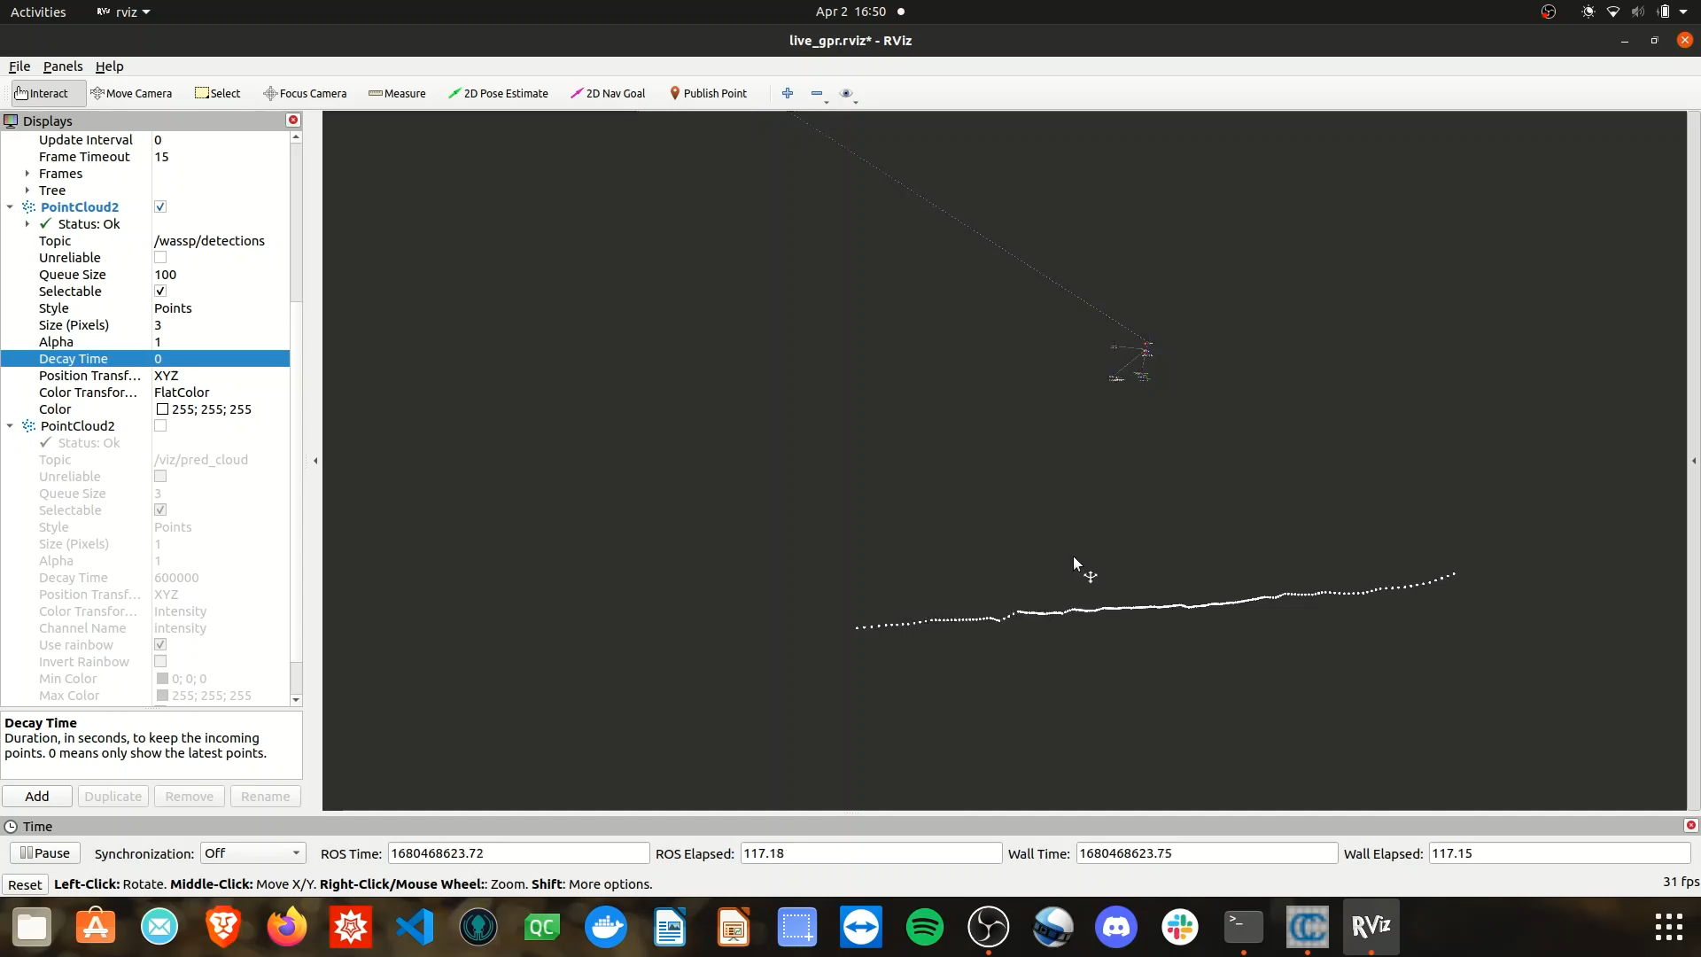
Questions
What errors to present?
What time metric to present?
Other open advice from committee

Slide 44
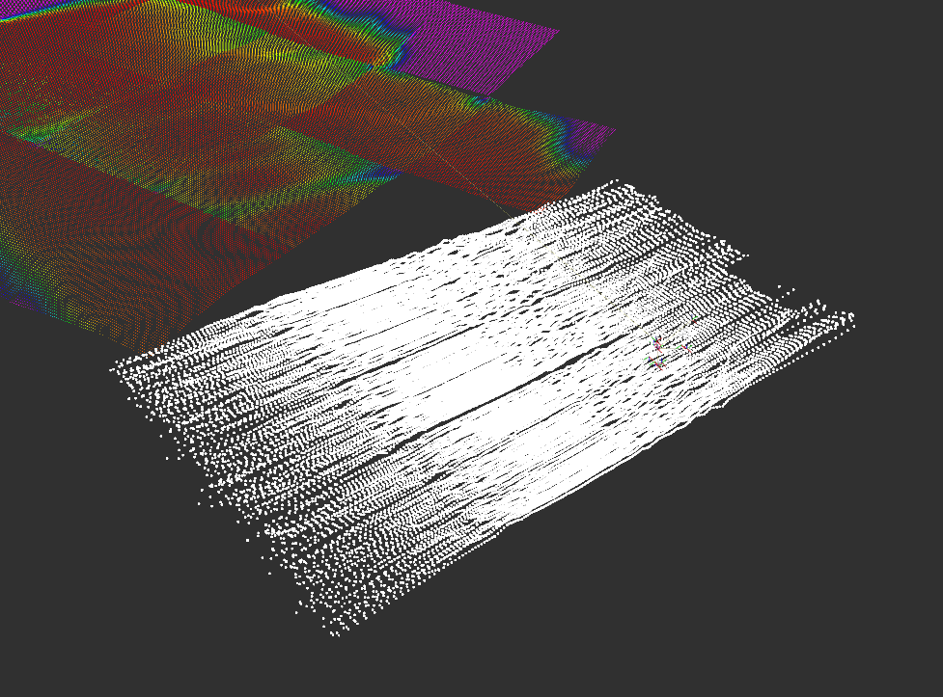
Massively Parallel Gaussian Process Regression
GPR model
pre-trained
live data
(pings)
prediction
tiles

Slide 45

Pings
Swath
$$input:labeled swath data$$

Slide 46
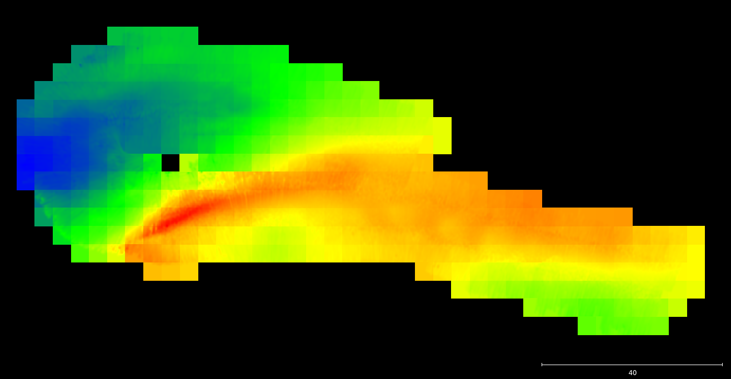
MP-GPR Flow
Tiles
$$output: predictions on dense grid$$

Slide 47
Massively Parallel Gaussian Process Regression
real-time updatable GPR solution
exact solution (uses all data)
number of computational speed-ups
runs on a GPU

Slide 48
Massively Parallel Gaussian Process Regression
requires heavy-duty GPU
constant sonar uncertainty
not as fast as it could be

Slide 49
Furthering Usability and Efficiency of Massively Parallel Gaussian Process Regression as applied to Multi-Beam Sonar Data
my work!

Slide 50
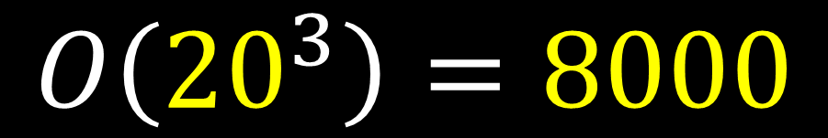
Let’s downsample!
What if…
We choose the ‘best’ M points from N?
$$O\left({20}^{3}\right)=8000$$

Slide 51
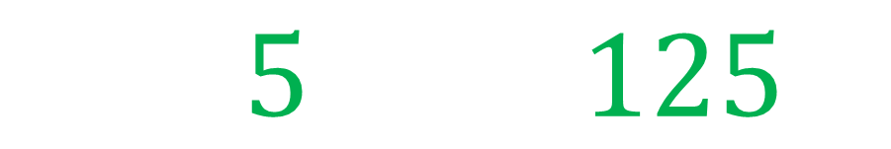
Let’s downsample!
What if…
We choose the ‘best’ M points from N?
$$O\left(5^{3}\right)=125$$

Slide 52



Let’s downsample!
as we use fewer points…
…the algo speeds up…
…and accuracy goes down.

Slide 53
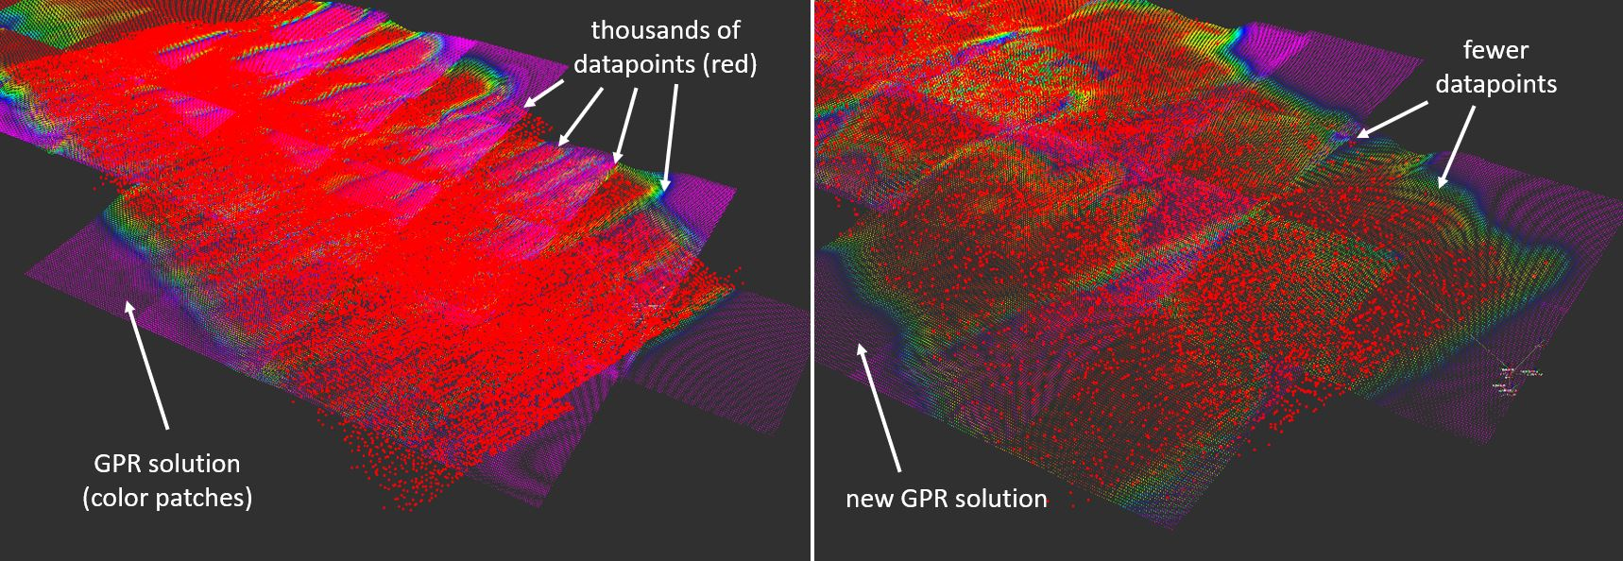
All datapoints (exact solution)
Downsampled (approximate solution)
Keep 10% of raw data

Slide 54



The Crux
$$\min_{ time}{ }$$
$${\max_{acurracy}{ }}$$
$$({\operatorname{MPGPR}{) }}$$
over each method and downsample percent

Slide 55
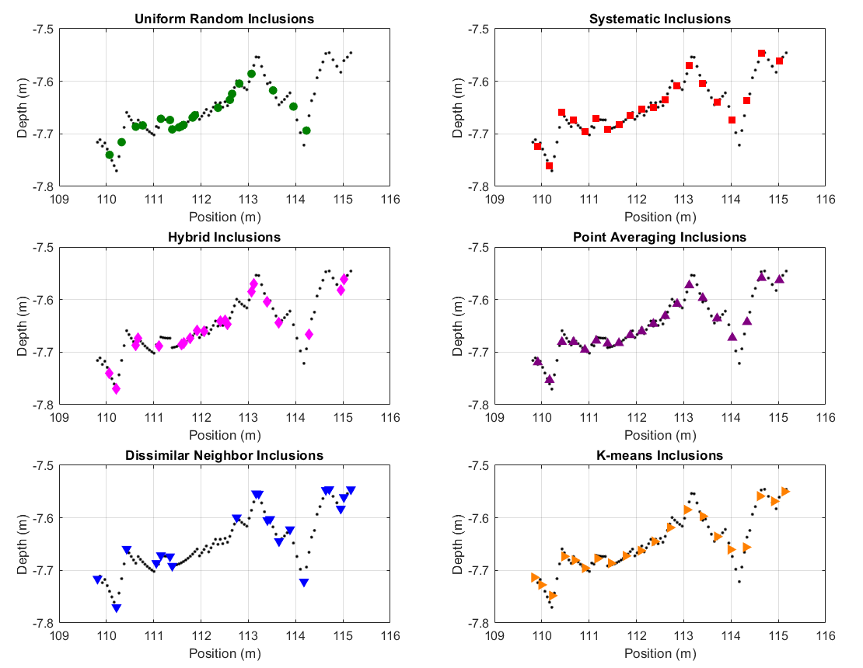
6
Methods
100 pts → 20 pts

Slide 56


Exact
100%
$$150m wide x 60m tall$$
$$330,000 pts$$

Slide 57
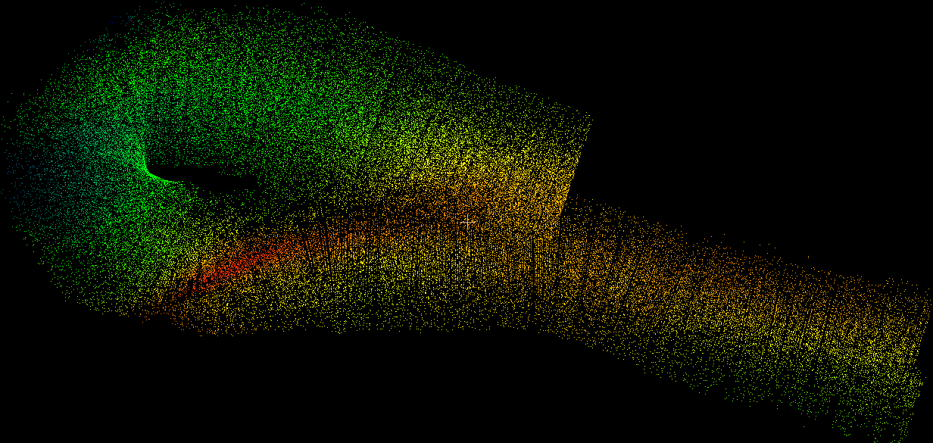
Random
20%

Slide 58
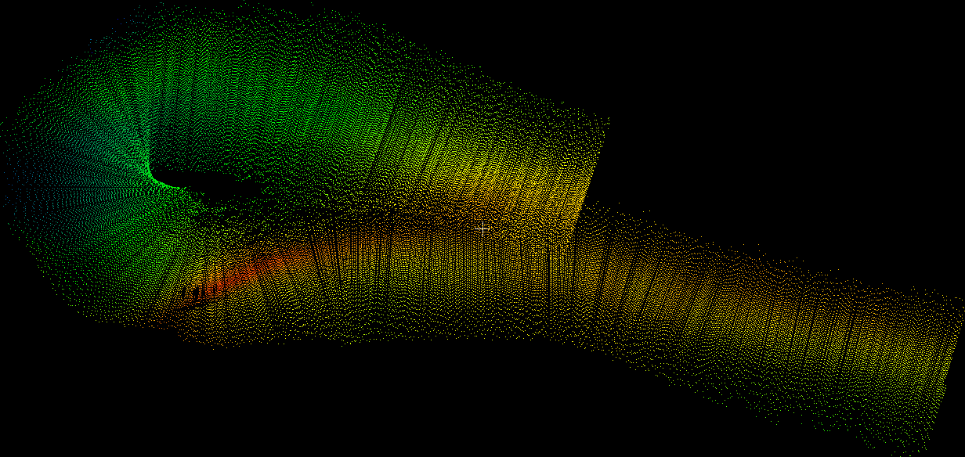
Systematic
every 5th pt
20%

Slide 59
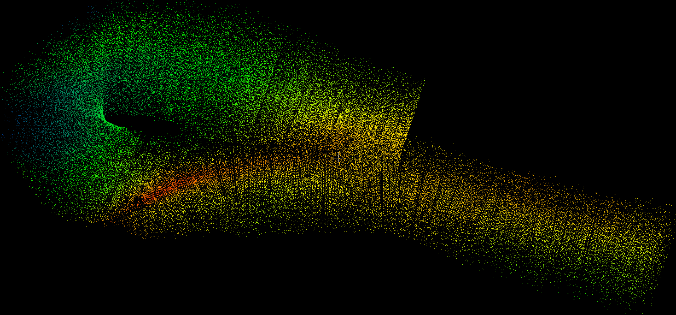
Hybrid
20%

Slide 60
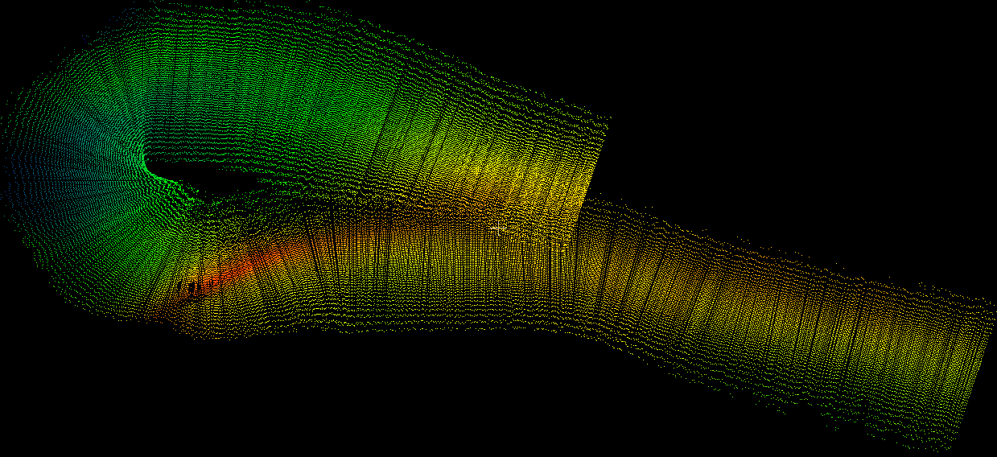
Average
20%

Slide 61
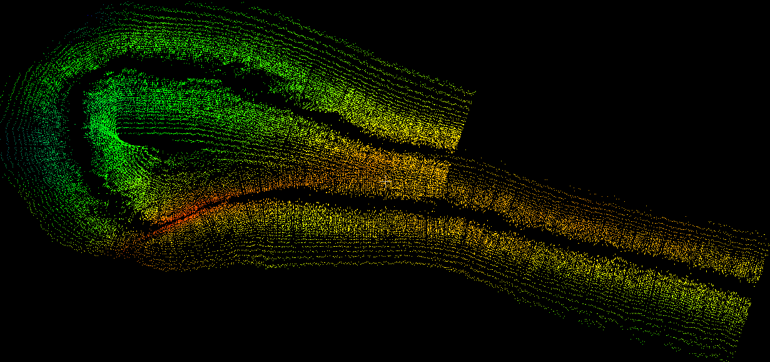
Dissimilar Neighbor
20%

Slide 62

Dissimilar Neighbor
20%
$d_{r}=$ $\frac{min(d_{i+1}, d_{i−1})}{max(d_{i+1}, d_{i−1})}$

Slide 63

Kmeans
20%
$$optimized random sampling$$

Slide 64
before…
Massively Parallel Gaussian Process Regression
GPR model
pre-trained
live data
(pings)
prediction
tiles

Slide 65
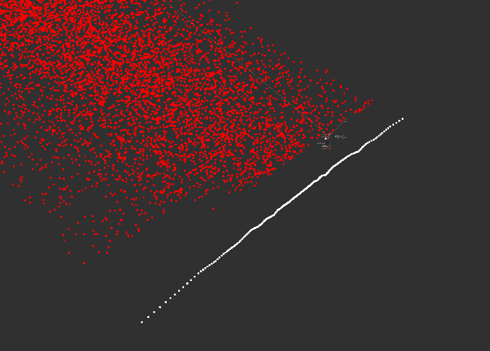
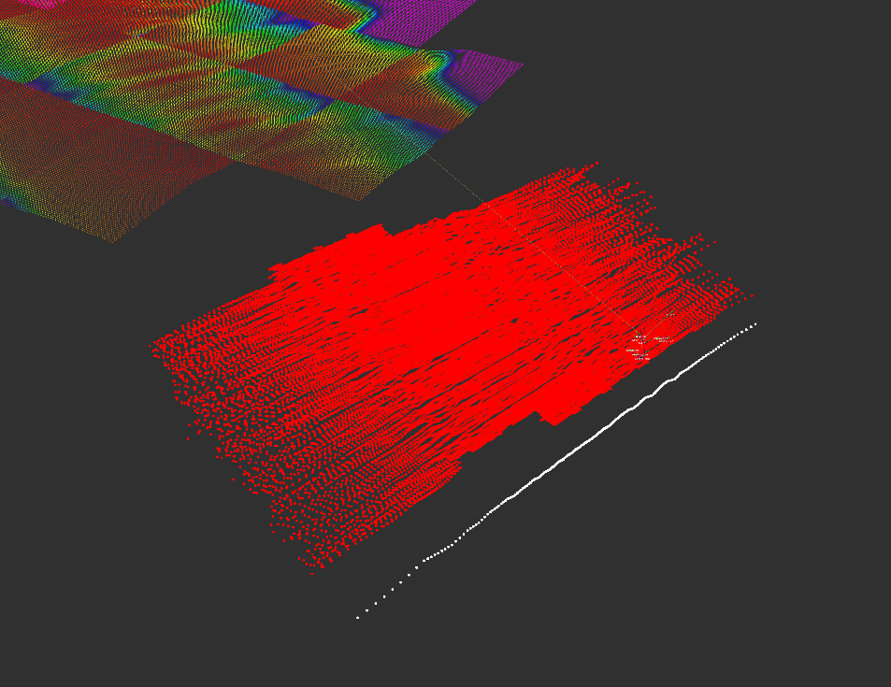
More efficient!
Massively Parallel Gaussian Process Regression
GPR model
pre-trained
downsampled
pings
prediction
tiles

Slide 66
More efficient!
Massively Parallel Gaussian Process Regression
GPR model
pre-trained
downsampled
pings
new prediction
tiles

Slide 67
What does pre-trained mean?
GPR model
pre-trained
downsampled
pings
new prediction
tiles

Slide 68
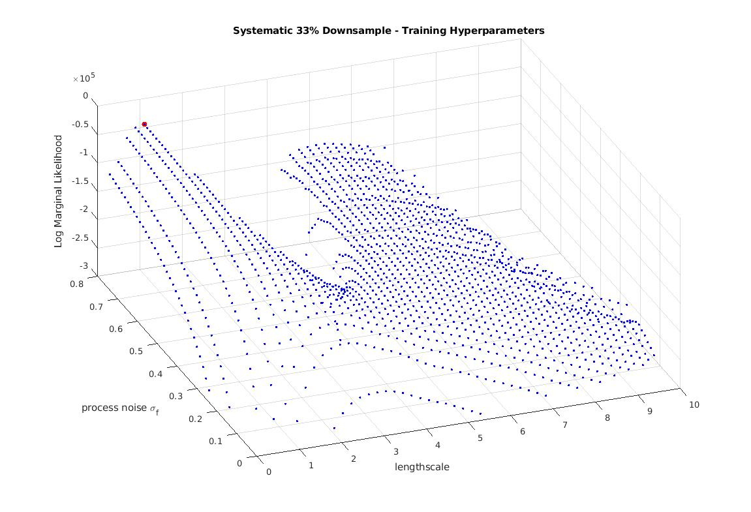
Training Hyperparameters
Maximize LML Plot
Log Marginal Likelihood (LML) maximization
LML
reward fit
punish complexity
normalize
process noise
lengthscale

Slide 69
Training Hyperparameters
Maximize LML Plot
Log Marginal Likelihood (LML) maximization
LML
bad solution zone!
bad solution zone!
The ‘max’ is dangerous
Choose a more reasonable pt
process noise
lengthscale

Slide 70
What about the hyperparams?
GPR model
pre-trained

Slide 71
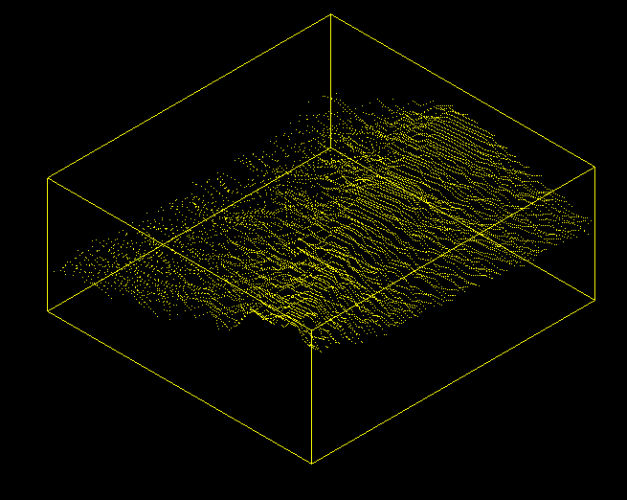
What about the hyperparams?
Train our
params
first!
w/
GPR model
pre-trained

Slide 72
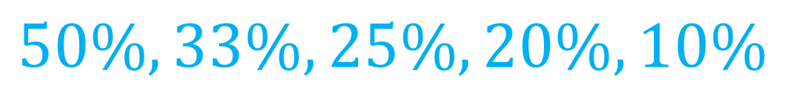

Running Trials
Percent of Points KEPT
Random, Hybrid, Neighbor, K-means
$$90\%, 80\%, …, 10\%$$
Systematic, Average
$$50\%, 33\%, 25\%,20\%,10\%$$

Slide 73
Running Trials
for each method {random, kmeans, ...}
for each downsample percent {90%, 80%, …}
1.) downsample swath
2.) train hyperparams on mini-patch
3.) run live
4.) post-processing to get stats
end
end

Slide 74
Running Trials
for each method {random, kmeans, ...}
for each downsample percent {90%, 80%, …}
1.) downsample swath
2.) train hyperparams on mini-patch
3.) run live
4.) post-processing to get stats
end
end

Slide 75
Running Trials
Exact Map (100%)
Approx Map (20% random)

Slide 76
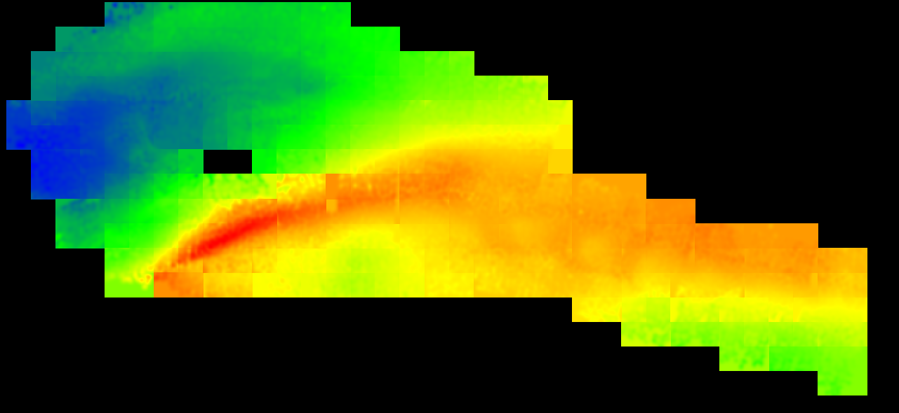
Running Trials
Exact Map (100%)
Approx Map (20% random)
92secs
20secs

Slide 77
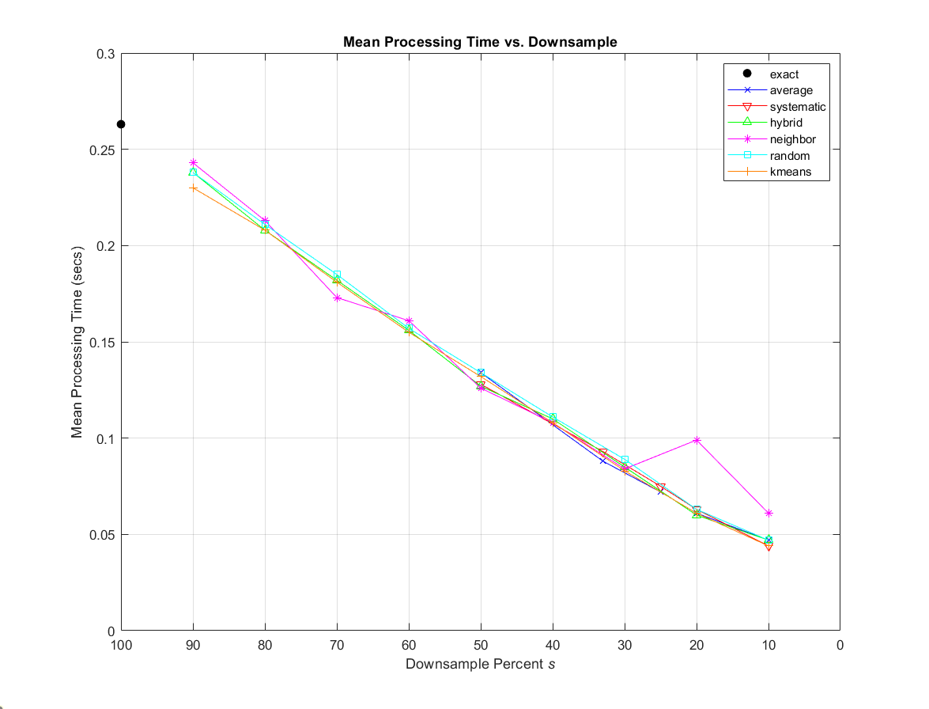
Compute Time vs Num Pts

Slide 78
Compute Time vs Num Pts
$$linear!$$
$$time≈constant∙s$$

Slide 79
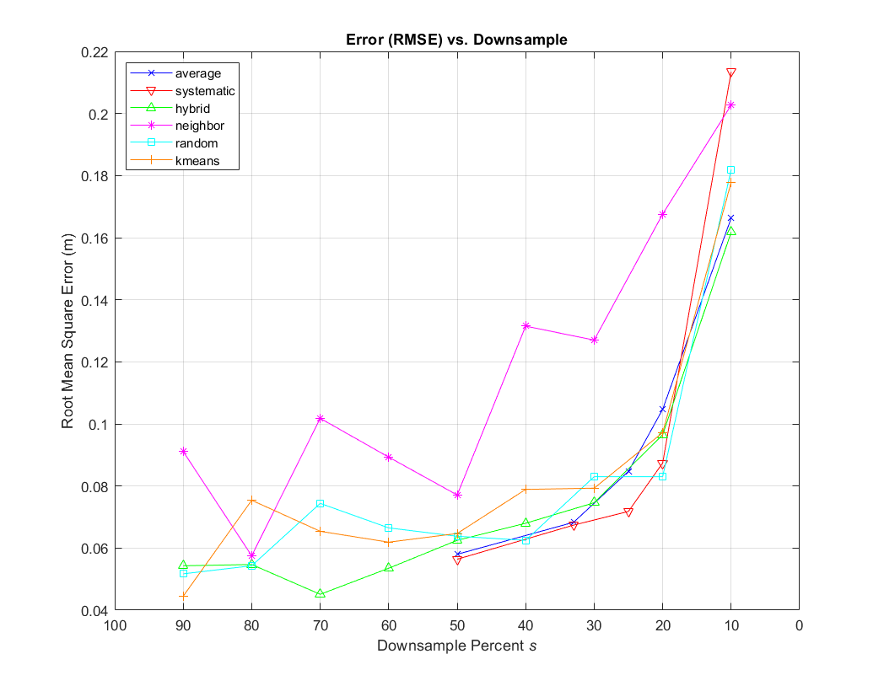
RMSE vs Num Pts

Slide 80
RMSE vs Num Pts

Slide 81
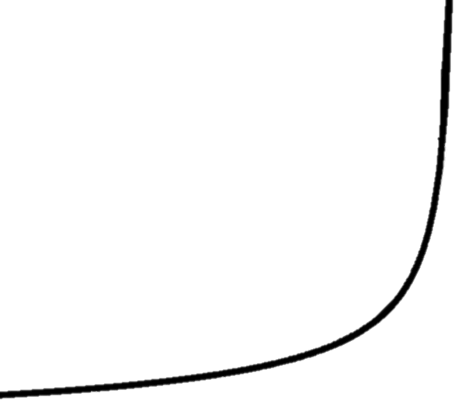

RMSE vs Num Pts
$$y=\frac{1}{\sqrt{s}}$$

Slide 82

RMSE vs Time

Slide 83
RMSE vs Time
fast + inaccurate
slow + inaccurate
20-30%
fast + accurate
slow + accurate

Slide 84

Conclusions
Compute time scales linearly
Accuracy scales $1/\sqrt{n}$
You can remove 2/3 of your data and be OK
Use simple downsampling methods
There’s room for more intensive downsampling approaches

Slide 85

Acknowledgements
Chris Roman, Mingxi Zhou, Peter Swaszek, & Paolo Stegagno
Kris Krasnosky & Roman Labmates
Faculty, mentors, family & friends
Office of Naval Research
Karl Rasmussen & many researchers

Slide 86
Thank you

Slide 87
Computation Time
Total Time = Downsample Time + Inference Time + overhead
Random
cheap
Systematic
cheap
should be relatively the same…
Hybrid
½ random + ½ systematic
same
Average
3N-calcs
depends on sparsity matrix!
Neighbor
3N-calcs
Random, then 20 iterations of N calcs
K-means

Slide 88



swath
ping
inference tile

Slide 89


Slide 90

CTD Cast
refraction negligible!

Slide 91


GPR Equations

Slide 92


Log Marginal Likelihood

Slide 93

Goes to zero after d > l (good for sparsity)
Continuous function when jumping to zero

Slide 94


Slide 95
Dissimilar Neighbor
Too much background?
SLAM acronym is wrong (5)
Slide 7, label right and left and features
Slide 8, environment* (where is the other *)
Slide 9 ASV Kayak (dave? K2?)
Slide 14 (maybe just Jordan’s feet)
Hanning vs hamming window?
Slide 21 label colorbar w/ unit [where was Jordan operationg on the graph]
Slide 23 (bottom left title)
Slide 28 – too much
Results were lost a bit
Intro to hp’s
Bring in the changing uncertainty
Credit stock photos
O(20^3) = ?

Slide 96


Slide 97


Slide 98


Slide 99


Slide 100


Slide 101


Slide 102


Slide 103
THE FOLLOWING SLIDES CONTAIN OLD RESULTS

Slide 104

Results

Slide 105
Results

Slide 106



Results
$$y=\frac{1}{\sqrt[3]{s}}$$
$$y=\frac{1}{\sqrt{s}}$$

Slide 107

Results

Slide 108
Results
$$time≈constant∙s$$

Slide 109
Results
$$time≈constant∙s$$

Slide 110

fast + inaccurate
slow + inaccurate
fast + accurate
slow + accurate

Slide 111




What’s happening to our tiles?
Kmeans 50% inference tiles
Systematic 50% inference tiles
Neighbor 50% inference tiles
Random 10% inference tiles

Slide 112






Maybe it’s in the blocks…
Systematic 50% blocks
Kmeans 50% blocks
Average 50% blocks
Neighbor 50% blocks
Hybrid 50% blocks
Random 50% blocks

Slide 113





